Slide 1
LaTeX, knitR, and papaja

Slide 2
LaTeX – A document preparation system
LaTeX is a high-quality typesetting system; it includes features designed for the production of technical and scientific documentation. LaTeX is the de facto standard for the communication and publication of scientific documents. LaTeX is available as free software.
Install the TinyTex version of LaTeX FIRST, before doing any other installs for this project.
You will not have to interact directly with LaTex, but it must be installed for RMarkdown to find.
Use: > install.packages("tinytex")

Slide 3
knitR
knitR will allow you to write html documents with your code, and the results of your code, embedded directly into the document
The author of knitr, Yihui Xie has published some excellent materials online, and has written a book on the subject:
http://yihui.name/knitr/ overview page
https://github.com/yihui/knitr/tree/master/vignettes examples page
http://yihui.name/knitr/demos/ demos page
https://www.amazon.com/gp/product/1498716962?ie=UTF8&tag=7210-20 to buy his book
http://rmarkdown.rstudio.com/ Awesome source of materials from Rstudio folks
Obviously, there’s a ton of materials online, plus a book. So we’ll just be doing a high level introduction to whet your appetites

Slide 4
Creating reports
LaTEX is the premier scientific publishing tool available, and R has a scientific literate programming tool called Sweave, which would “weave” text and datasets together.
More recently, rmarkdown, based on knitr has become very popular.
Allows you to embed R code into a markdown document, which is then knitted to produce HTML output.
“knit” refers to the process of running the R code, then embedding the results directly inside the text
rmarkdown extends knitr to also create pdf or Word documents, and HTML presentations.
http://cran.r-project.org/web/packages/rmarkdown/index.html
http://rmarkdown.rstudio.com/

Slide 5
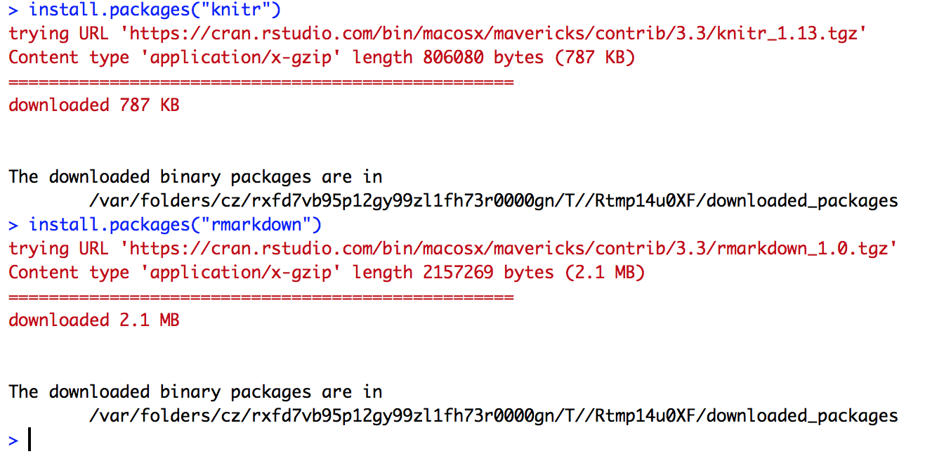

Slide 6
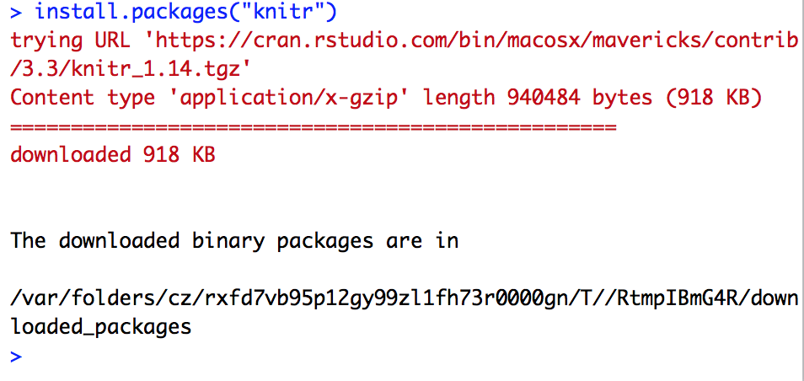
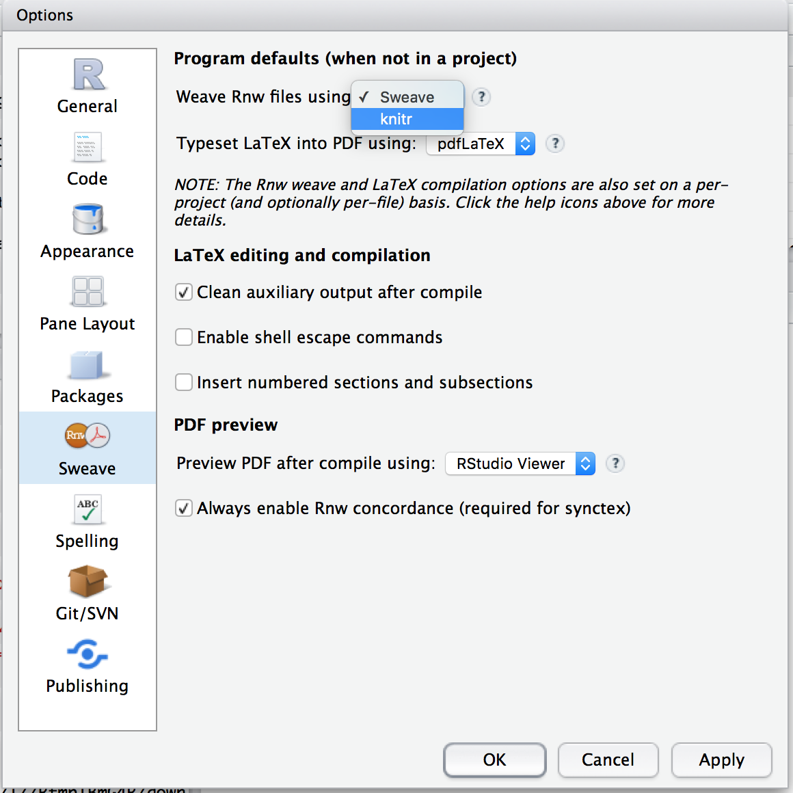
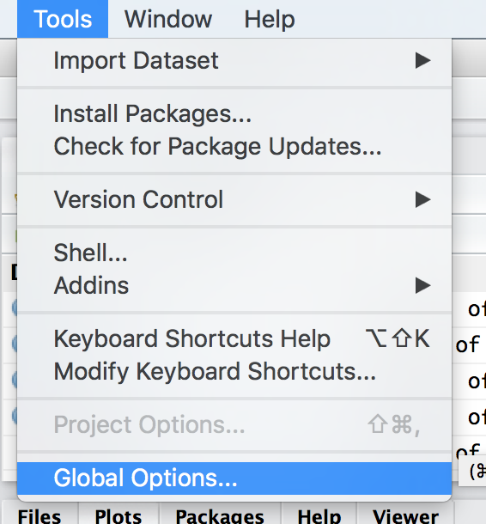
Installing knitR and configuring RStudio

Slide 7
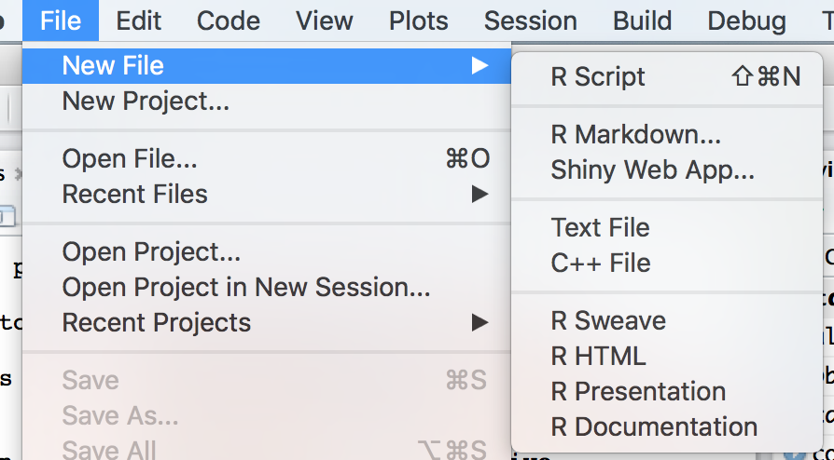
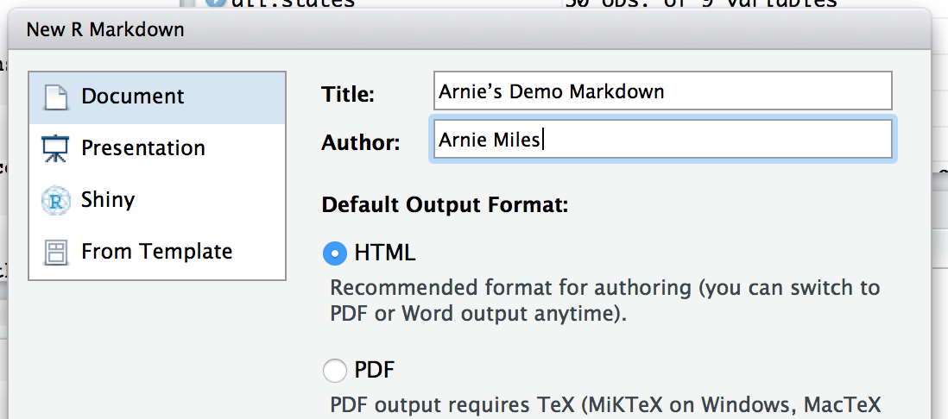
Getting started

Slide 8
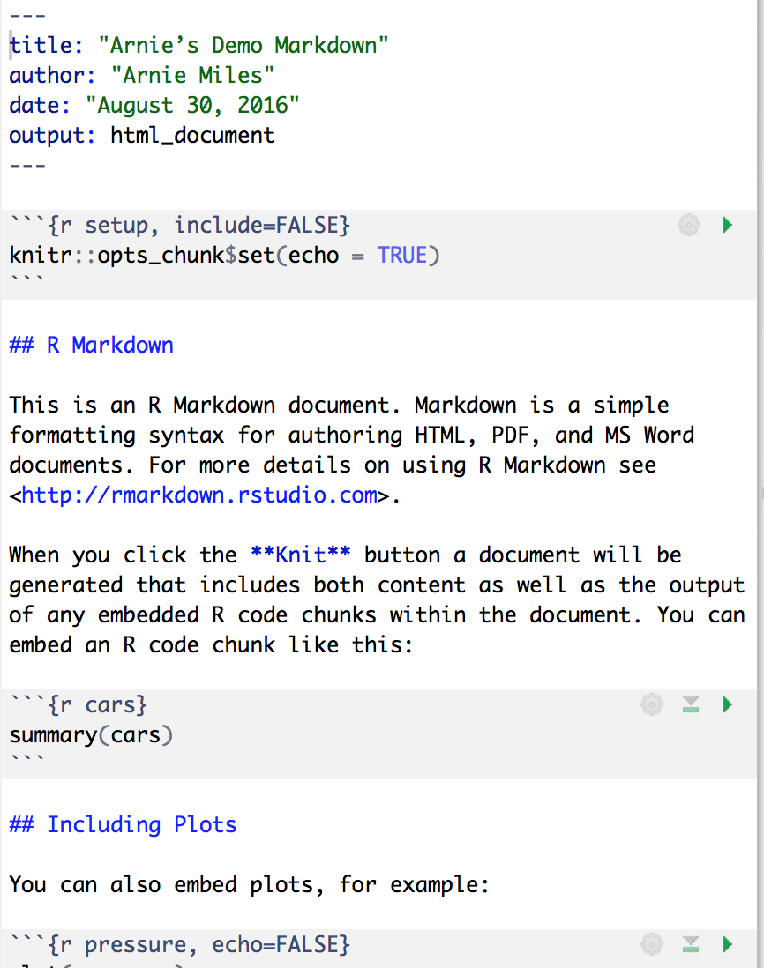
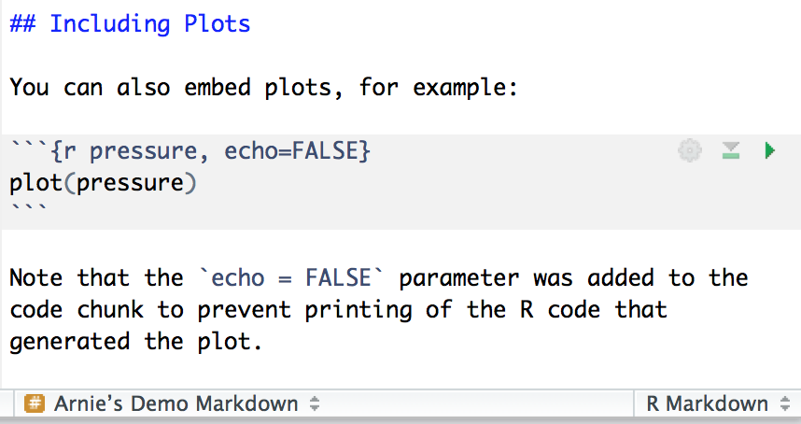
Here’s what you get, right off the bat.
Notice that the information I typed in when I started the package has become a nicely formatted heading.
Clicking on the green arrows in this will produce the results of that section of ‘code’, either in the console, or in the case of the plot, in the plot window.

Slide 9
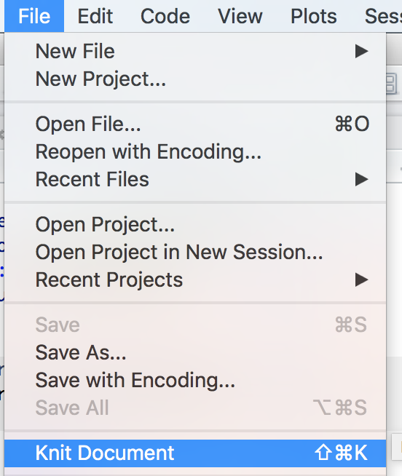
So?
Let’s just save the current document, and see what the default looks like. We’ll ‘knit’ the document and create a web page:
It may ask what format, just choose system default
Results split on the next couple of slides

Slide 10
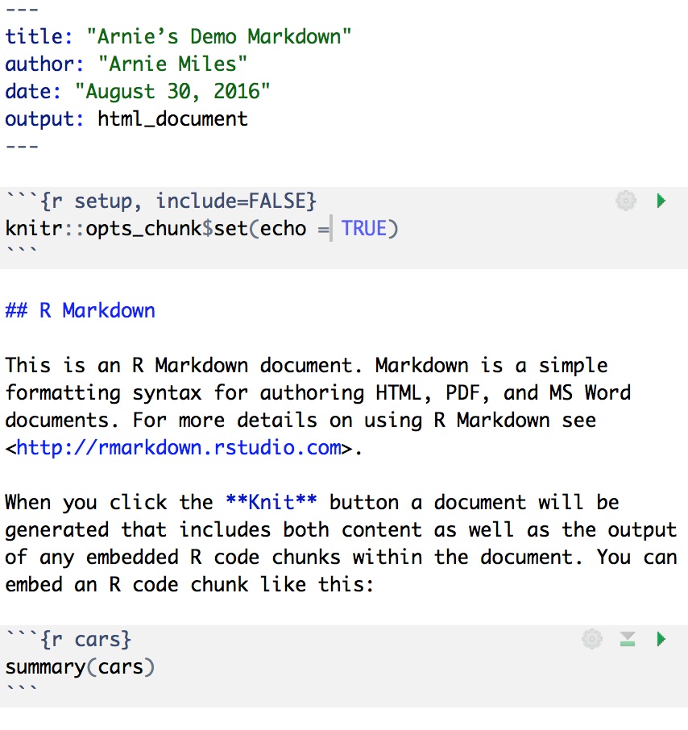
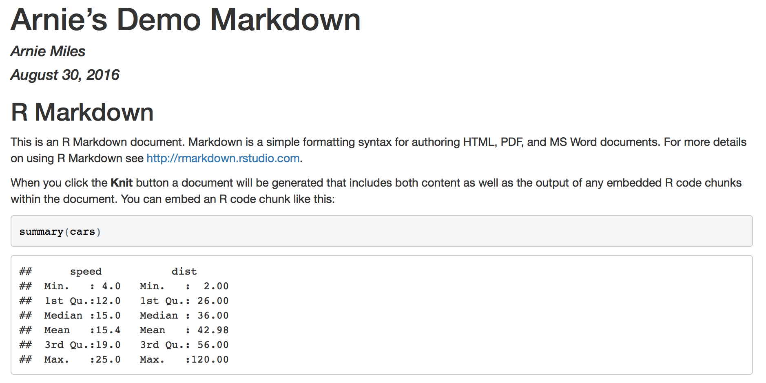

Slide 11
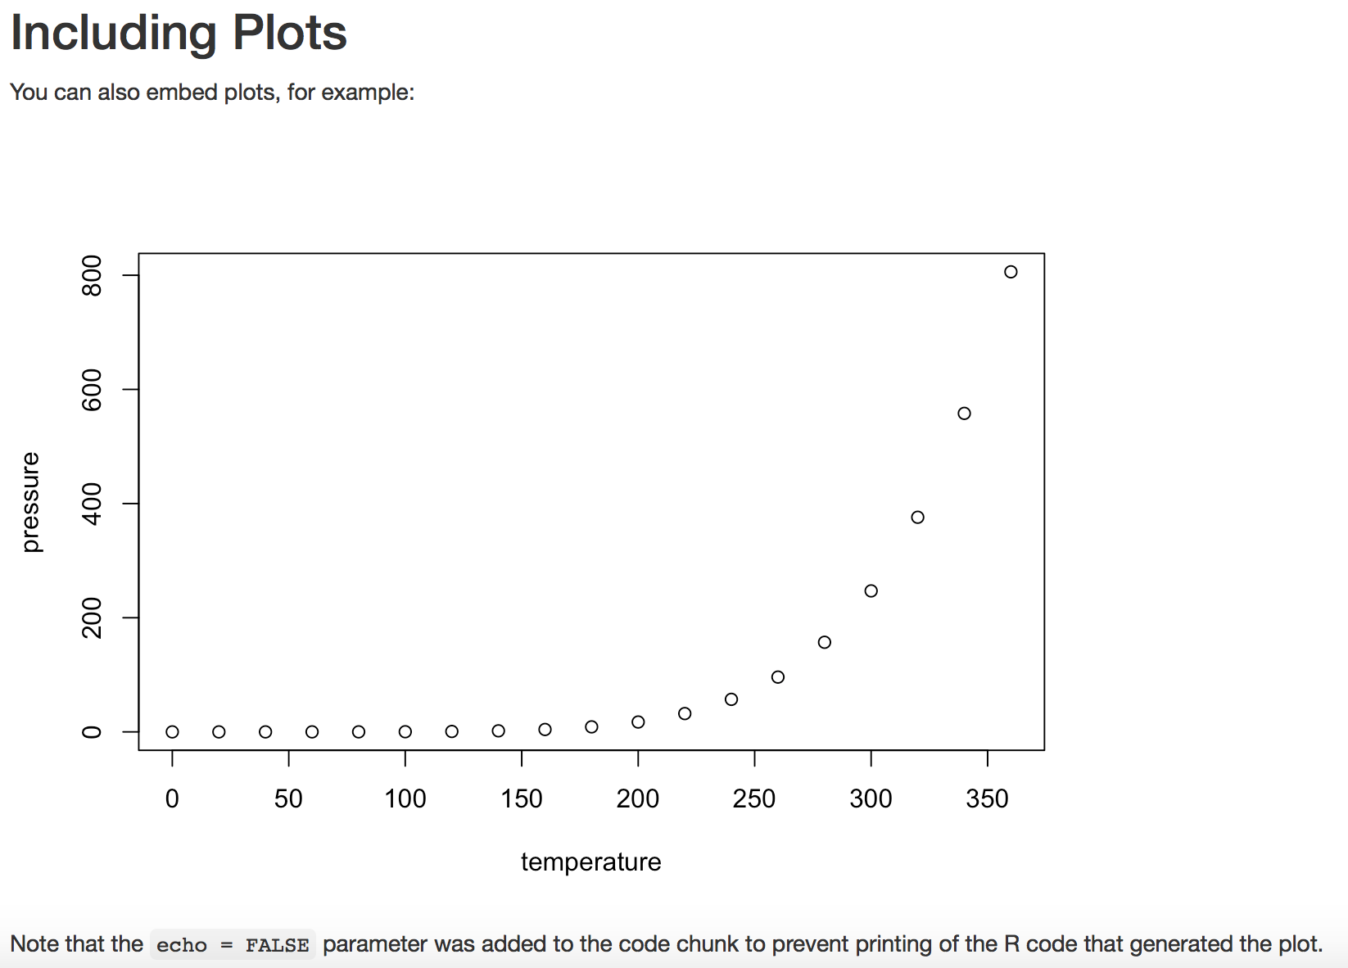
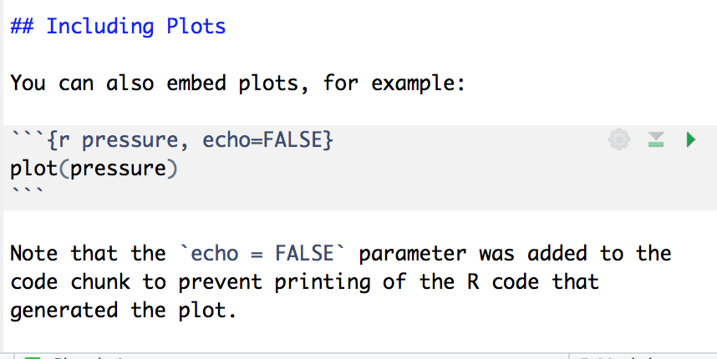

Slide 12
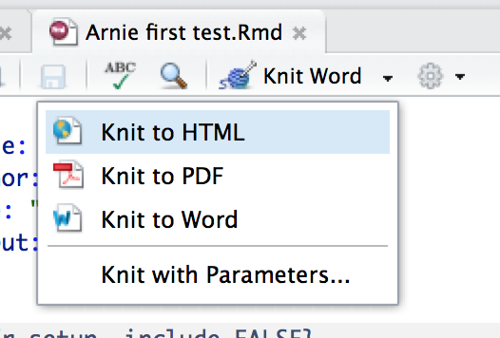

Exporting to word
The default setting will create an html document, which can be pretty cool for sharing with teammates or publishing directly to the Internet
Knitting to Word is pretty straightforward. Select this option, then go knit your file. You’ll get a formatted Word document.

Slide 13
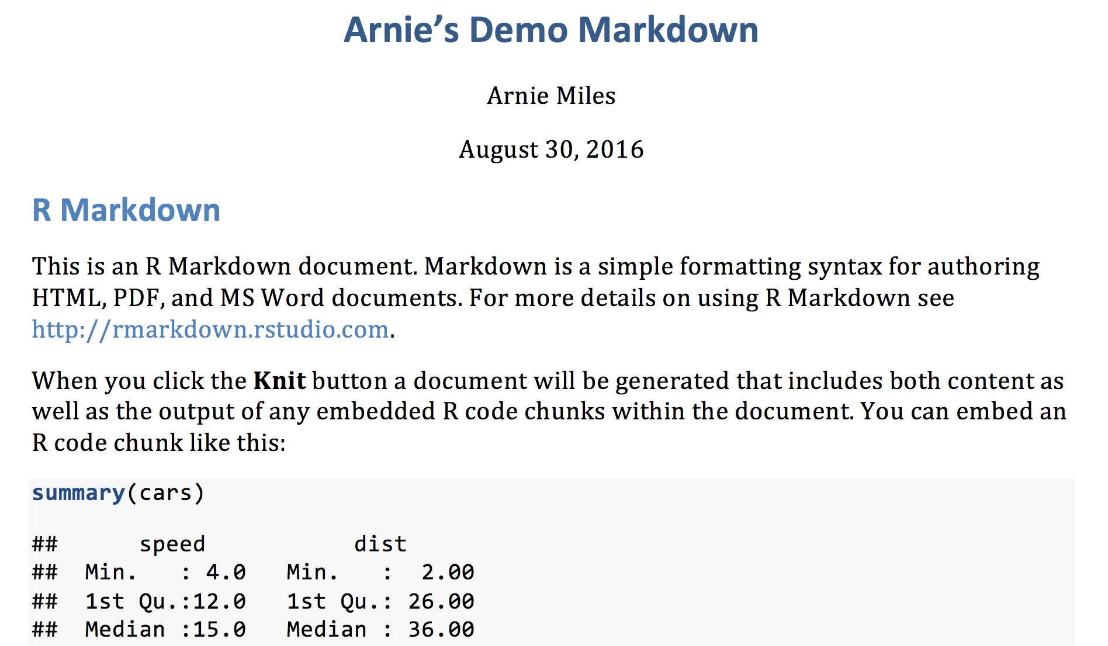
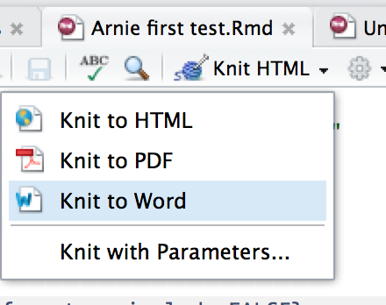
Exporting to Word
Choose Knit to Word

Slide 14
Exporting to pdf
knitR and RMarkdown rely on LaTeX to create near typeset quality pdf documents.
LaTeX must be installed before RMarkdown and knitR
If you already had RMarkdown and knitR installed before you installed LaTeX, re-install them so they can find the LaTex executable.
You must test your installation by making a pdf before continuing.

Slide 15
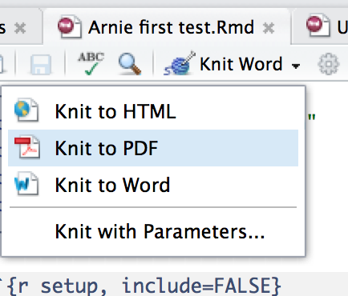
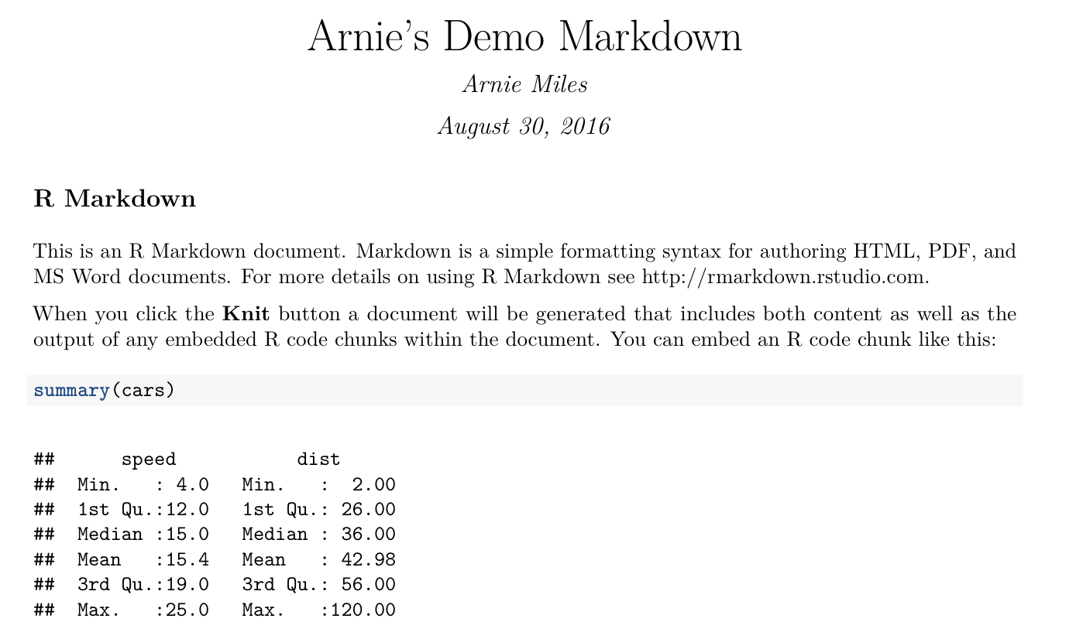
Exporting to pdf

Slide 16
Header and body
The header is called a YAML header, and a default header is created when you create a new knitR document
You can edit this, for example add html links or even R code (see the next couple of slides)
The YAML header is enclosed with --- before and after the header
## indicate the equivalent of an html <h2> tag (more markdown syntax follows)
Regular text is just typed in as text

Slide 17
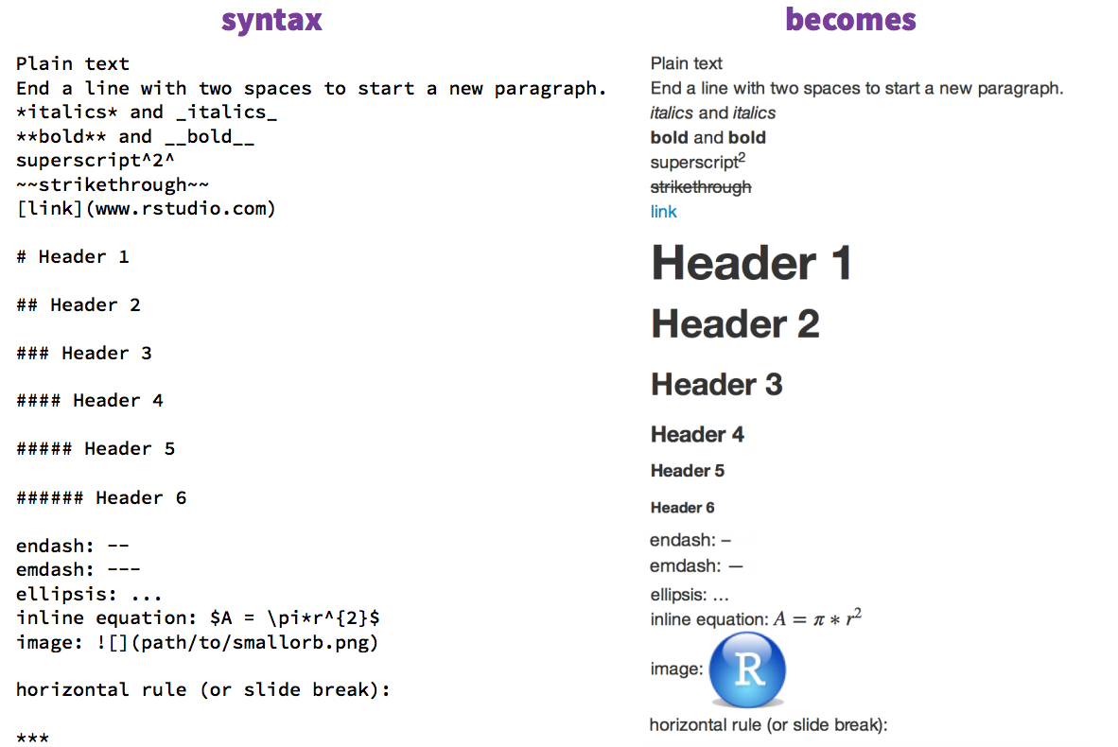
Some formatting tags
The Rstudio website includes a knitR cheat sheet
https://www.rstudio.com/wp-content/uploads/2015/02/rmarkdown-cheatsheet.pdf
Here is some tidbits pulled from that site

Slide 18
Inserting code
Code is inserted into your markdown documents in the form of “chunks”
Inline code chunks are put between single back-ticks: `code`
Based upon the concepts of reproducible data, writing something like: “There are 163 individuals is poor coding, because while there may be 163 individuals today, what will there be when you, or someone else, tries to reproduce your results?
Instead: “There are `r nrow(my_data)` individuals”
Never break an inline chunk across lines

Slide 19
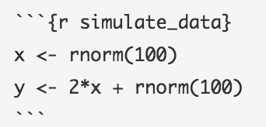
Inserting code
Larger chunks are added in multiple lines between three backticks
The examples on the following pages are from knitr in a knutshell by Karl Broman
http://kbroman.org/knitr_knutshell/pages/overview.html
In this example, the three backticks indicate the beginning of a chunk, inside the brackets we announce that we’re using R and give this a name
That is followed by some R code, and closed with the three backticks

Slide 20
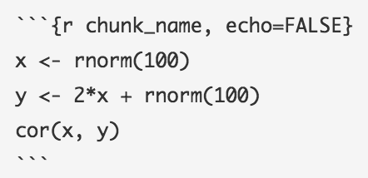
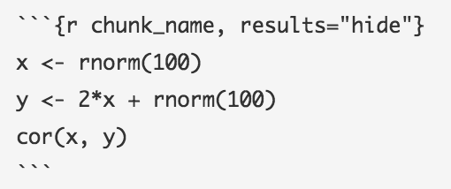
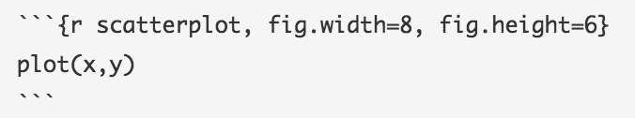
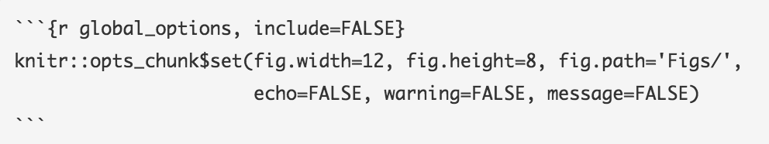
This first example shows how to display the output of your code without echoing the code to the screen.
The opposite example, you want to display your code but not print out the results. Great for collaborative writing.
Here’s a simple diagram
Finally, it is often useful to set global options. If you want the same settings used throughout your document, set them once at the beginning. This is good programming practice in any language. This allows you to set all the outputs to “hide” during collaboration, then reset them them to show at publication time with only one change!

Slide 21
Select literate programming and reproducible research readings
http://www.literateprogramming.com/knuthweb.pdf
http://akkartik.name/post/literate-programming
https://cran.r-project.org/web/views/ReproducibleResearch.html
http://kbroman.org/steps2rr/

Slide 22
APA style is hard
Errors are rampant.
The most common errors are:
missing or incorrect running head (86.3%)
errors with in-text citations (84.0%)
missing or incorrectly formatted page numbers (75.0%)
incorrect margins *52.2%)
indentation of the first line of each paragraph (43.1%)
Life is too short for memorizing APA style!

Slide 23
Templates
Templates can help you, provided you understand the basics
Word has a usable template
However, as we are using R for our statistics, and have already started using R markdown to create documents, a template that works with knitR would be useful
That template is papaja
papaja has other templates as well, but we will concentrate on APA

Slide 24
Installing papaja
This is going to take a little patience, possibly a little googling, and possibly help from your peers. Don’t give up.
Start by updating your installation of R, Rstudio, and your version of LaTeX. Don’t skip this step. You must install the FULL version of TeX, not an abbreviated version.

Slide 25
Installing papaja
This is going to take a little patience, possibly a little googling, and possibly help from your peers. Don’t give up.
Start by updating your installation of R, Rstudio, and your version of LaTeX. Don’t skip this step. You must install the FULL version of TeX, not an abbreviated version.
No, seriously. I’m not kidding. Do NOT skip this step! Go update everything and make sure you have the full version of LaTeX. The odds of getting errors is VERY HIGH if you don’t. And the errors will be difficult and incomprehensible.

Slide 26
Installation
The following represents the most successful installation procedure I’ve seen:
> install.packages(c('devtools', 'curl'))
> devtools::install_github("crsh/papaja")
On my Mac I ran into a licensing issue, and had to go to the command line to run:
sudo xcodebuild -license

Slide 27
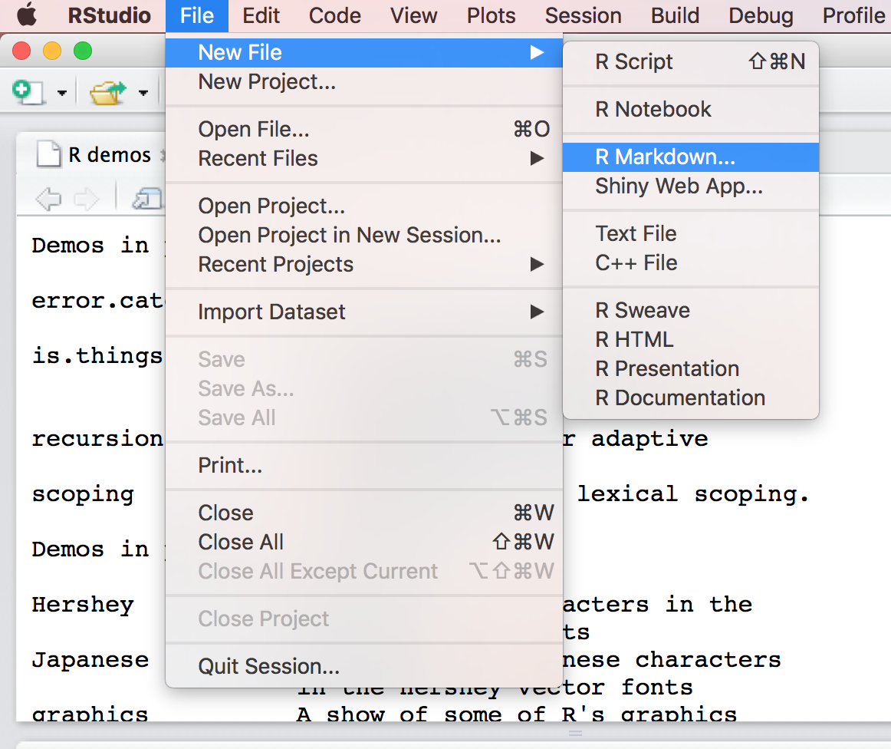
Create a Document

Slide 28
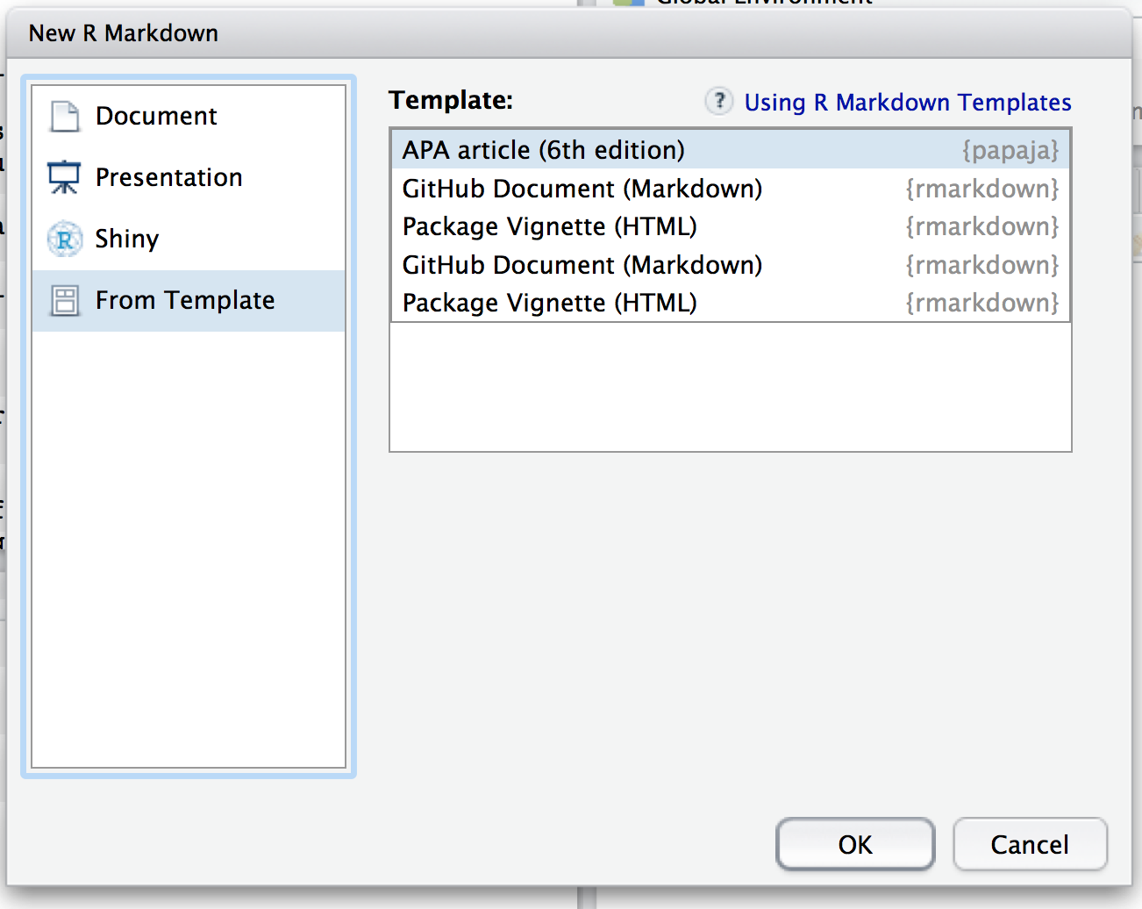
Choose Your APA Template

Slide 29
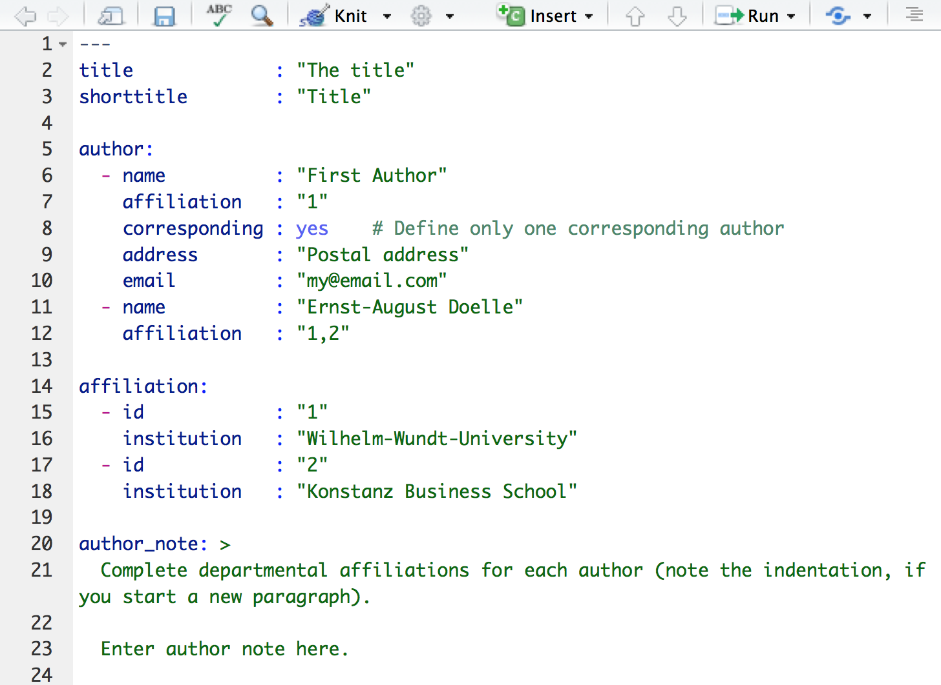
Default Template to Work With

Slide 30
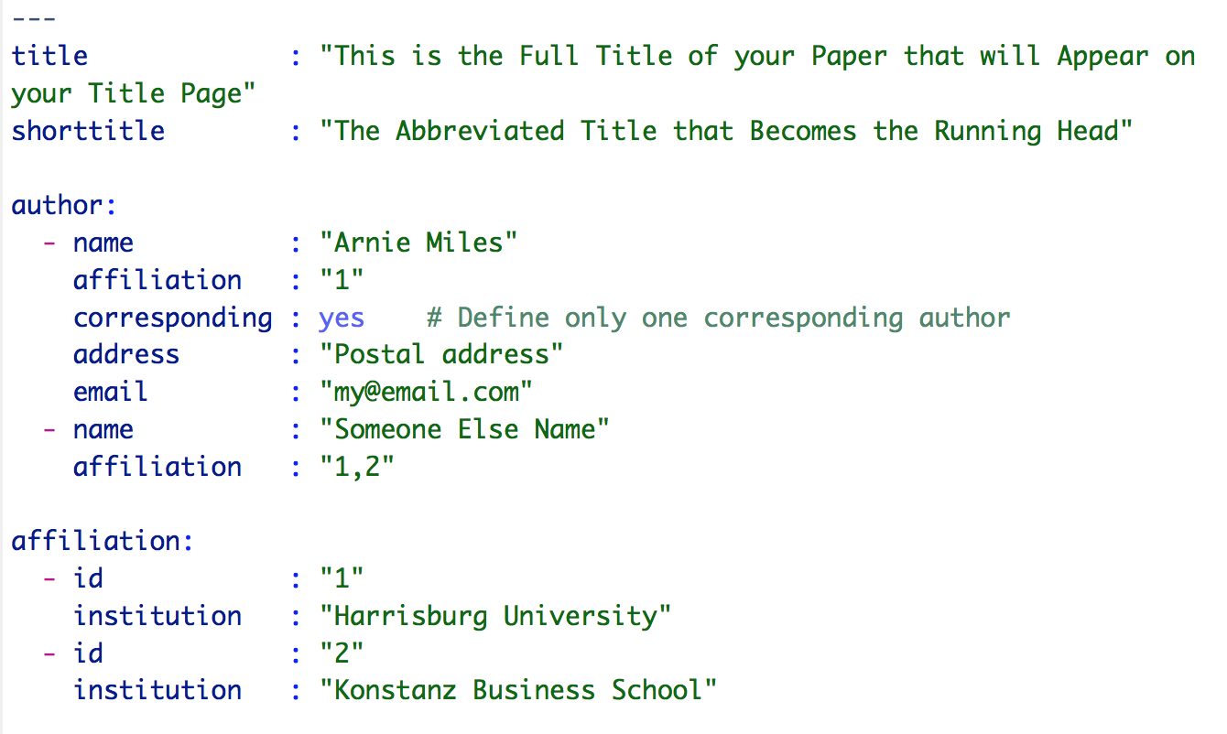
Edit the file

Slide 31
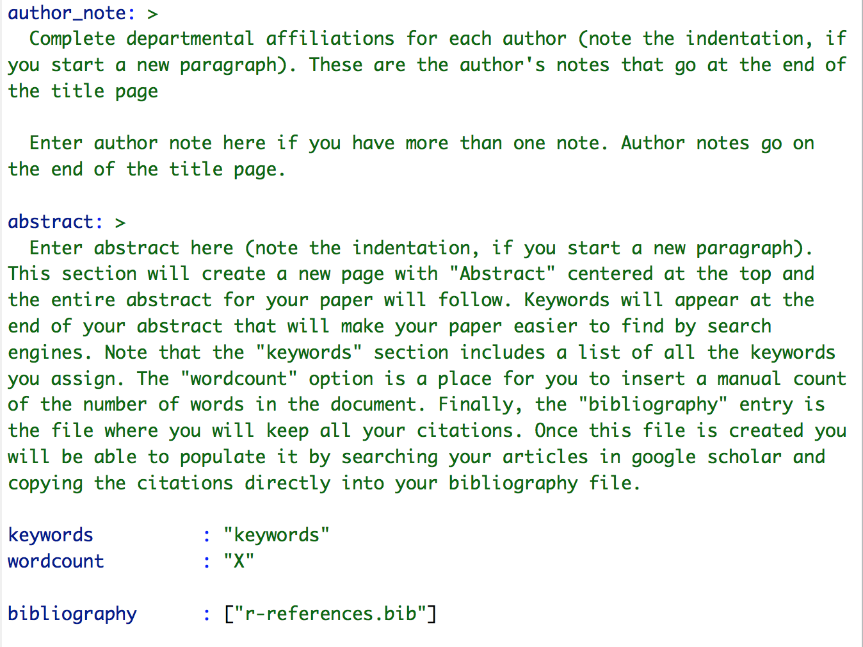
Edit the File

Slide 32
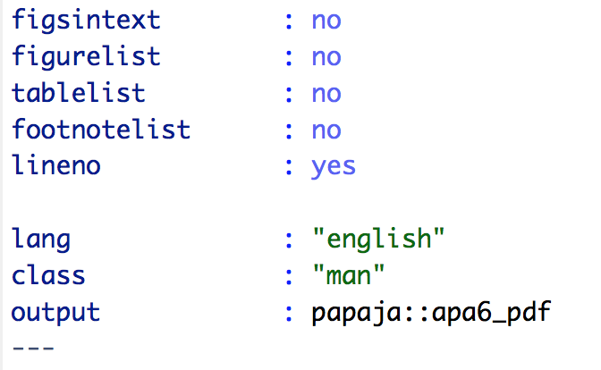
Items from the default that are worthy of note

Slide 33
The Rest of the Default File
All the standard headers for a standard APA document are included
All the standard r chunks from knitR are recognized
papaja has some cool additional R chunks, we’ll see some examples on the next slides
A proper and correct References page will be created automatically by reading in and formatting your .bib file

Slide 34
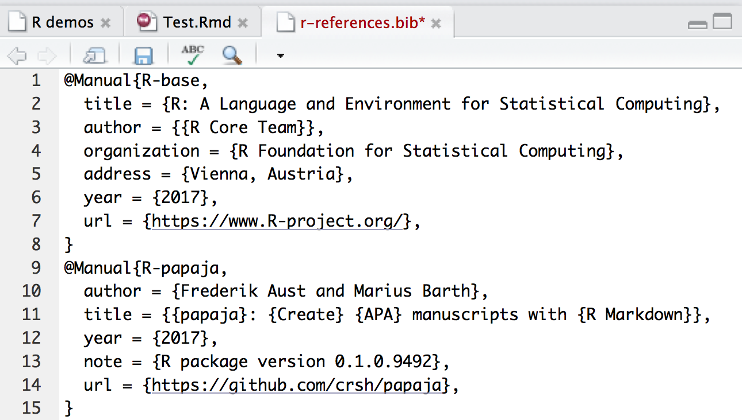
Sample .bib file
Open your .bib file with RStudio
This example has two references already, one to the R core team, the other to some paper the default file uses
Let’s add another perfectly formatted citation

Slide 35
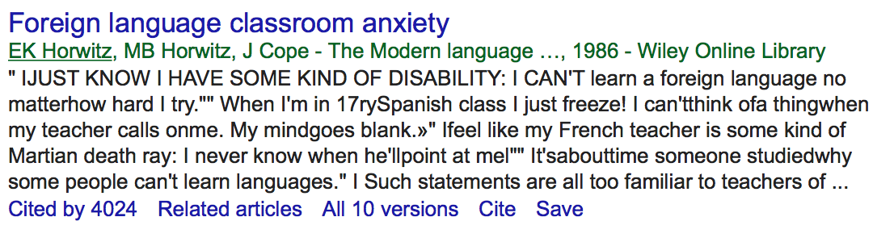
Adding citations to .bib files
Search the article in Google Scholar
Click on ‘Cite’ at the bottom of the citation

Slide 36
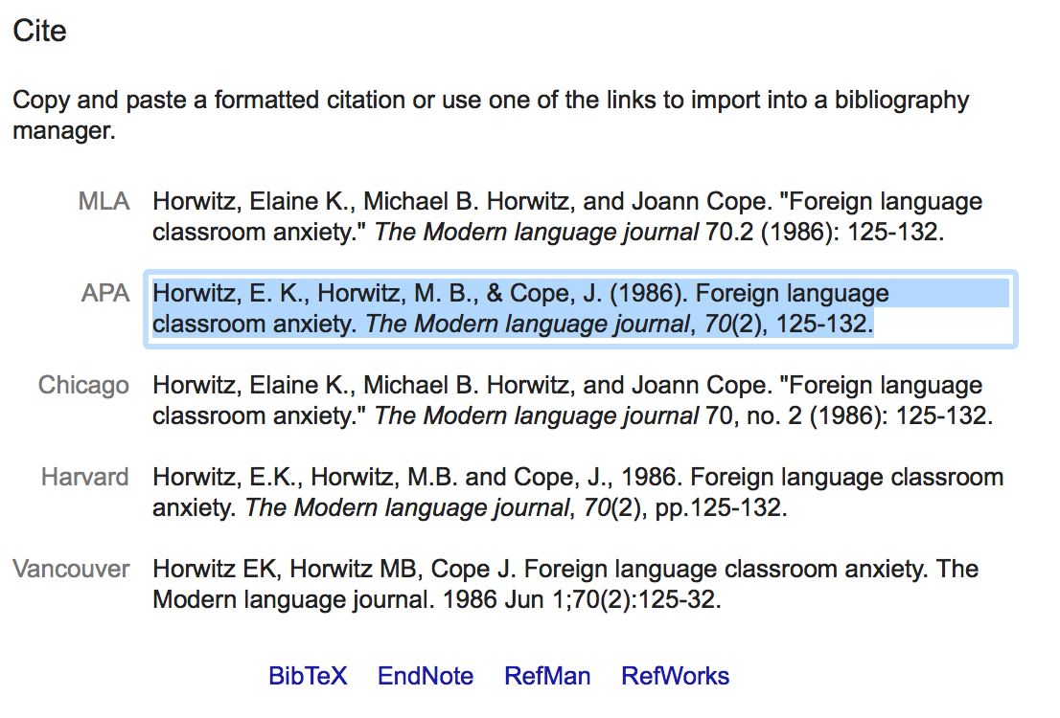
Adding citations to .bib files
Click on APA, then on BibTex at the bottom

Slide 37
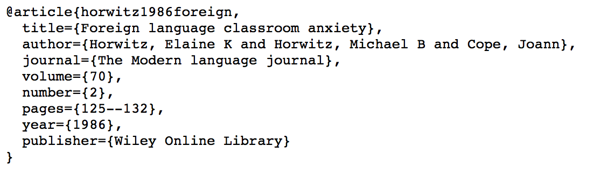
Copy citation to clipboard

Slide 38
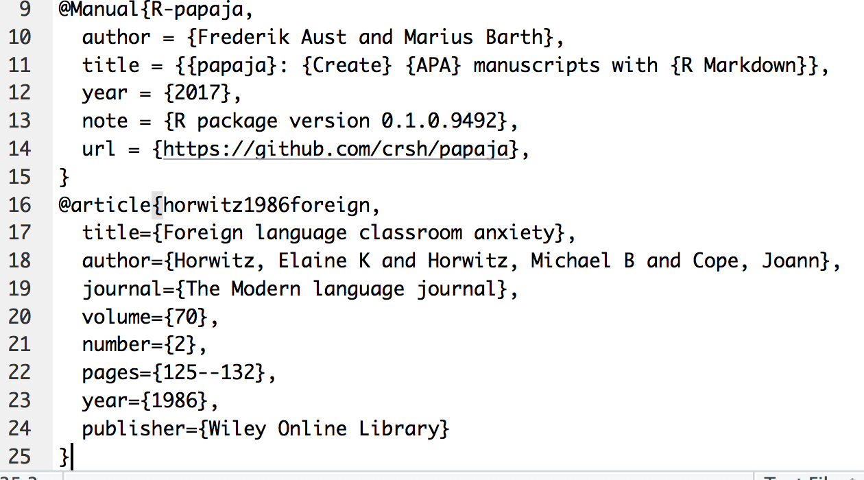
Paste into your .bib file in RStudio

Slide 39
BibTeX entries for R and R packages
R, papaja, and all other R packages used should be cited
papaja will create the BibTeX entries for R and papaja automatically, don’t remove these entries when you’re customizing your paper from the default template
From your RStudio console, type citation(“package_name”) to retrieve the correct BibTex entry for any R package
This matters, people put in a lot of time, frequently unpaid, to create R and the various packages that you use, citations are currency in academia

Slide 40
Inline citations
Examples from http://rmarkdown.rstudio.com/authoring_bibliographies_and_citations.html
Citations go inside square brackets and are separated by semicolons. Each citation must have a key, composed of ‘@’ + the citation identifier from the database, and may optionally have a prefix, a locator, and a suffix. Examples follow:

Slide 41
Citation examples
Normal Citations:
Blah blah [see @doe99, pp. 33-35; also @smith04, ch. 1].
Blah blah [@doe99, pp. 33-35, 38-39 and *passim*].
Blah blah [@smith04; @doe99].
For in-text citations, remove the square brackets:
@smith04 says blah.
@smith04 [p. 33] says blah.

